Slide 2
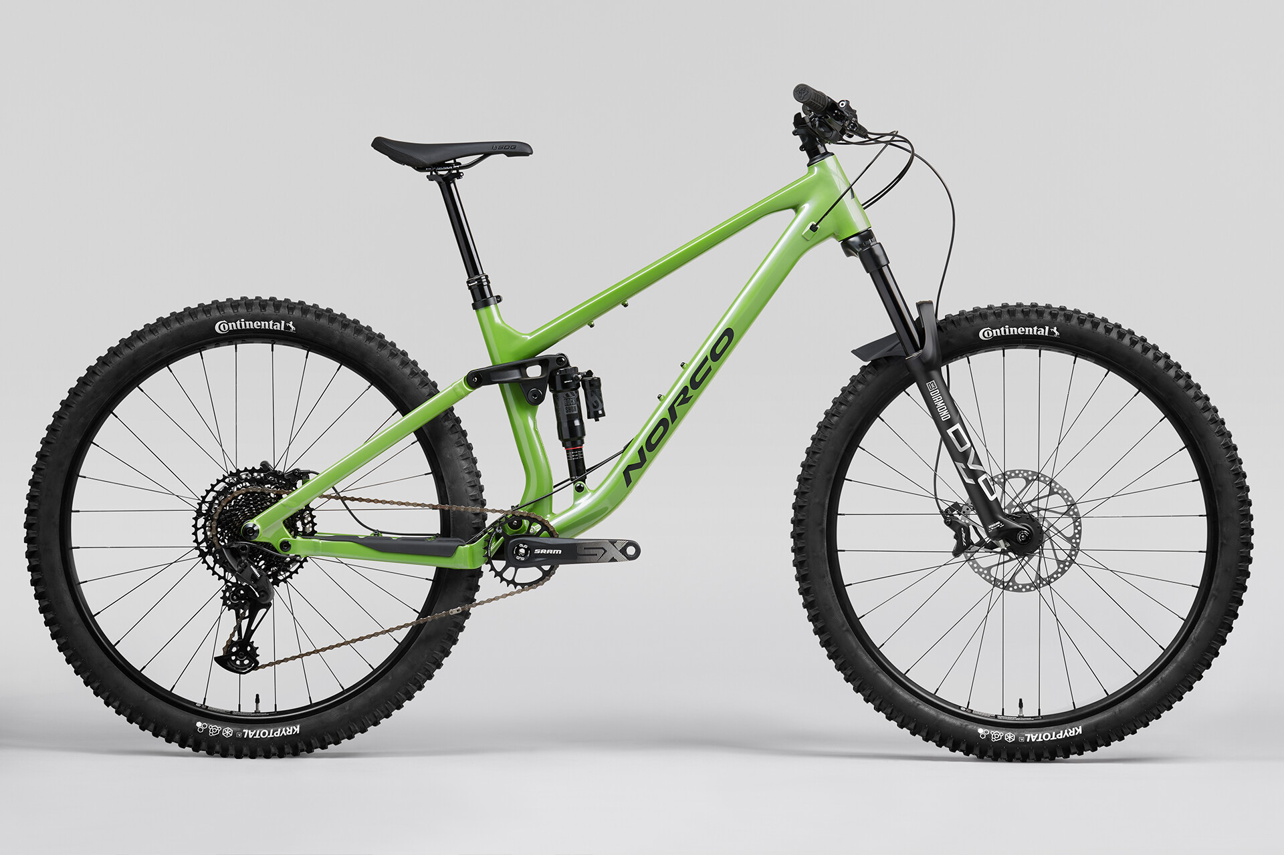
Controller
Firebeetle ESP32 Microcontroller
Front Sensor
Rear Sensor
6DoF Accelerometer
Xiao ESP32C6 Microcontroller
Battery
6DoF Accelerometer
Battery
Xiao ESP32C6 Microcontroller

Slide 3
Overview
Controller (Receiver)
Firebeetle ESP32
ESP-NOW wireless Rx Comms to front/rear sensors
Wifi Access Point/Hosted Webpage for Data Vis, Status
Battery
SD Card
Storage for Data
Data format for I2 or RS2 Analysis/Data Vis
GPS (Future Work)
9DoF Accelerometer (Future Work)
Over The Air (OTA) Updates
https://randomnerdtutorials.com/esp32-ota-elegantota-arduino/

Slide 4
Overview
Front/Rear Sensors (Senders)
XIAO Seeed ESP32C6
ESP-NOW to Controller
SPI comms to accelerometer
Data log to flash or SRAM before sending packets to Controller
Battery
LiPo pouch, maybe coin cell? Depends on packaging
Accelerometer
6DoF

Slide 5
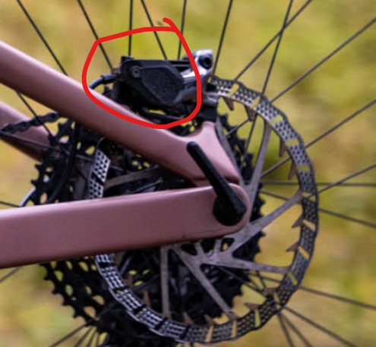
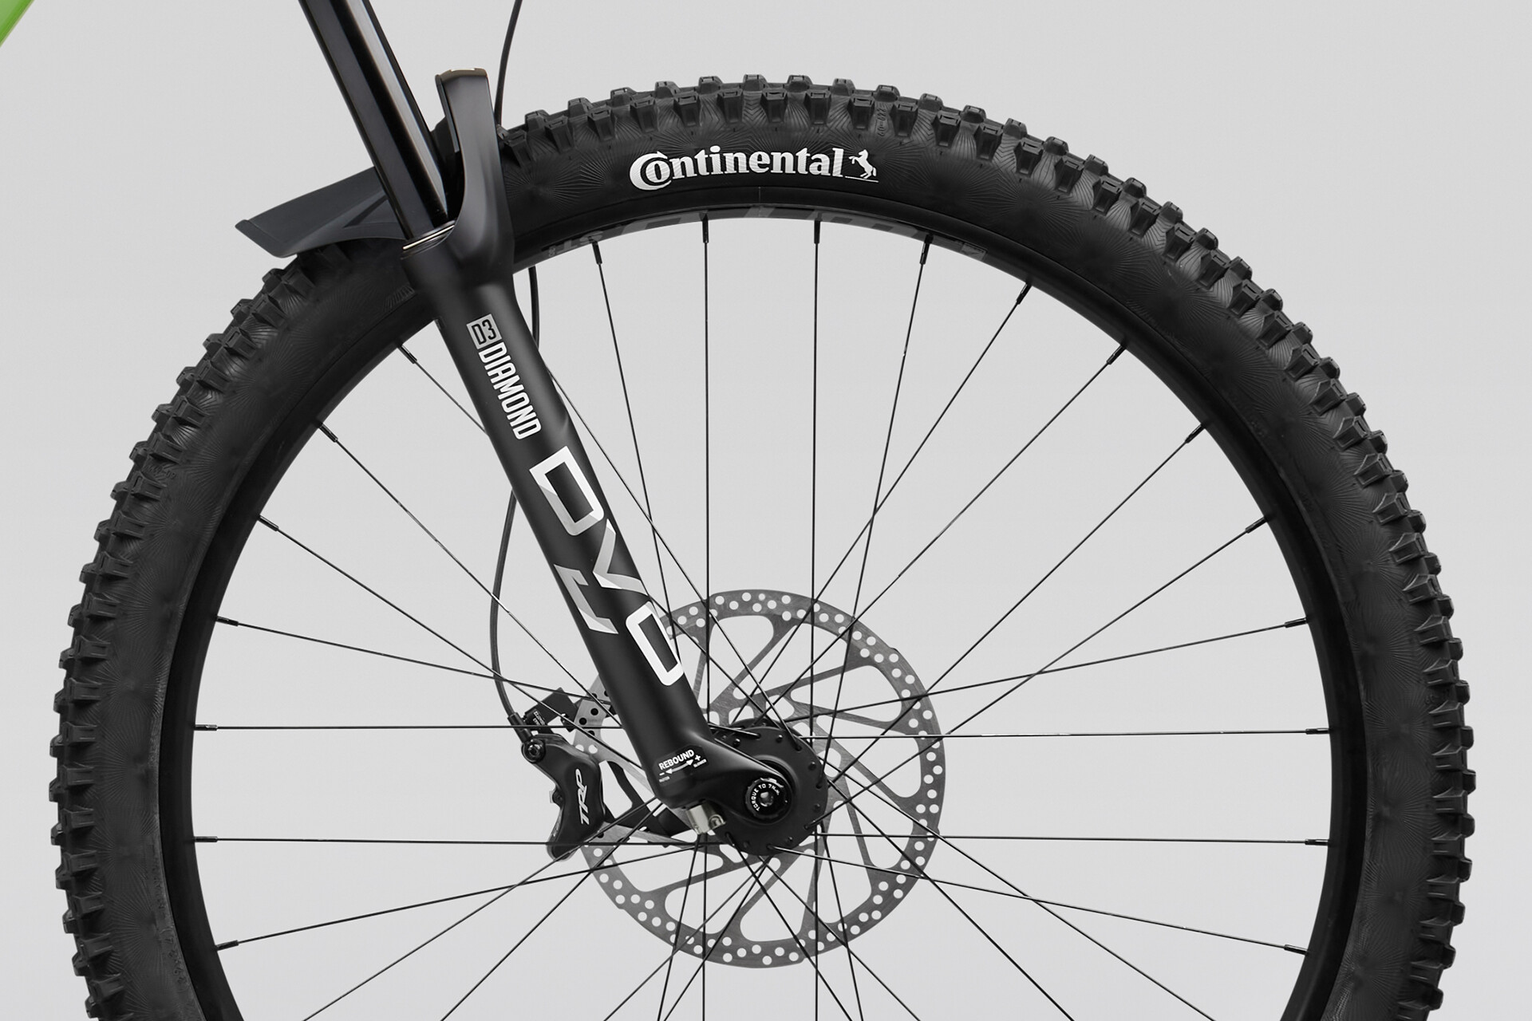
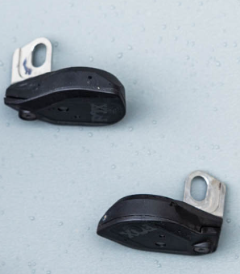

Slide 6
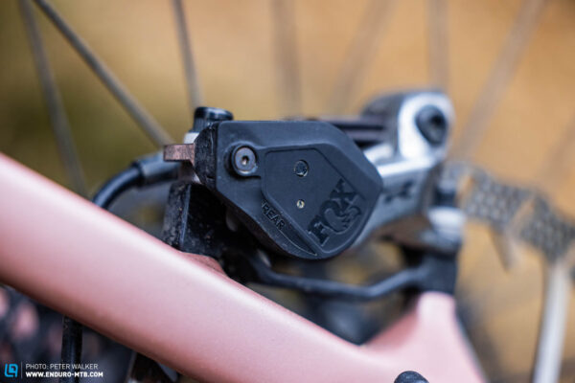
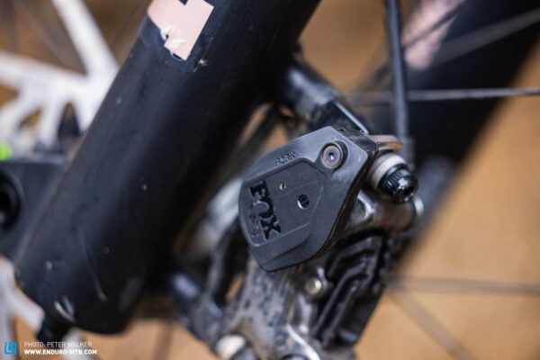

Slide 7
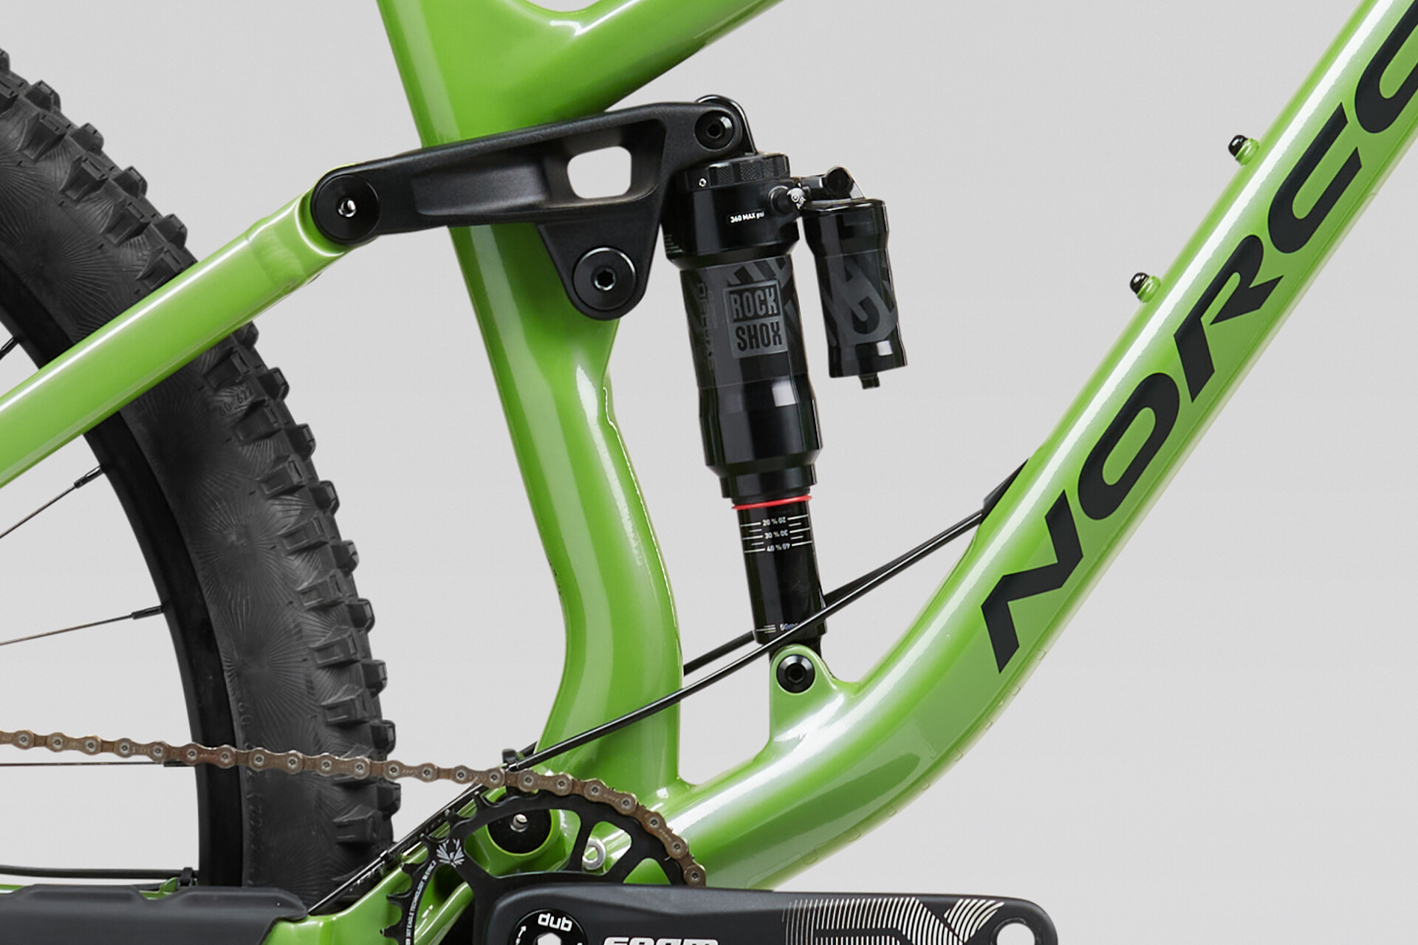

Slide 8
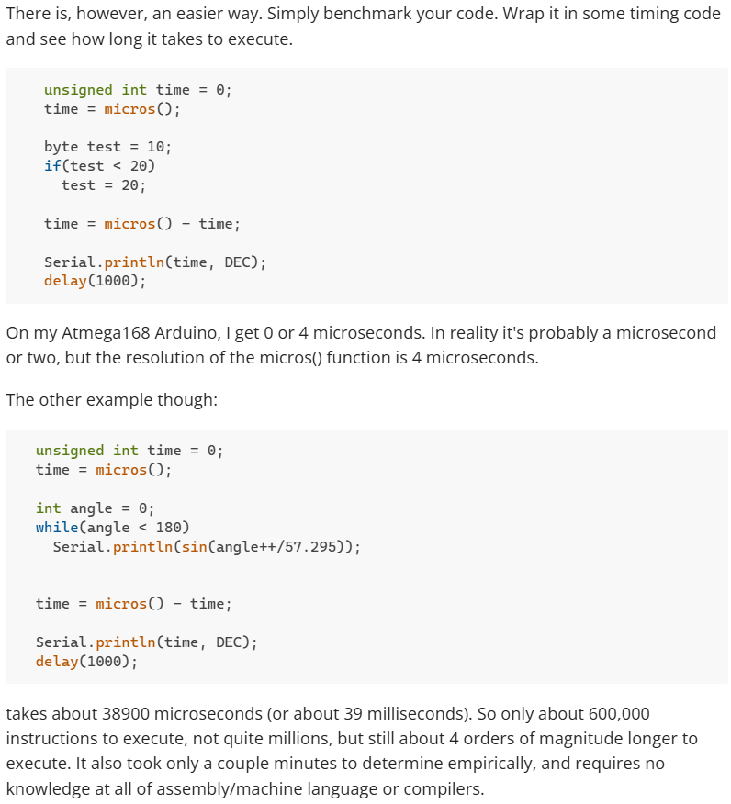

Slide 9
Controller
Firebeetle ESP32 Microcontroller
Front Sensor
Rear Sensor
6DoF Accelerometer
Xiao ESP32C6 Microcontroller
Battery
6DoF Accelerometer
Battery
Xiao ESP32C6 Microcontroller

Slide 10
Data Handling (Future)
Crash Detection
Vs Drop detection
Ride Quality Parameters (Andrew/George)
Activity recognition/steer angle/turning
Air vs Ground recognition for “flight time”

